Slide 1
Why Information Management is so Important?
Increase access to data
Save time & build efficiency.
Inform strategy:
Select, assess & manage issues;
Map & engage with stakeholders;
Inform strategic choices & activities;
Measure activities & actions;
Measure impact & evaluate performance.
Demonstrate productivity:
Show value to organization (ROI);
Motivate team.
Security
Centralise & share knowledge;
Guarantee institutional knowledge & maintain a historical record.

Slide 2
What good Information Management can help with
Reliability and Validity
Reliability is about the consistency
Validity is about the accuracy
Complete & Accurate data
Accurate information & data
Analysis
Digital analysis of the data
Forecasts, trends & patterns
Visualisations
Notes:
You can be reliable invalid. Consistent measure of something not valid.
It can be unreliably valid. Some valid results, but a event spready of non-valid results
Solutions:
Check clearly that goals / objectives of measurement are clearly defined and operationalised
Ask third party for feedback on measurement
Look for more or different data
You can repeat measurement.
Try an find a second measure for same effect.
Have someonelse carry out the measurement

Slide 3
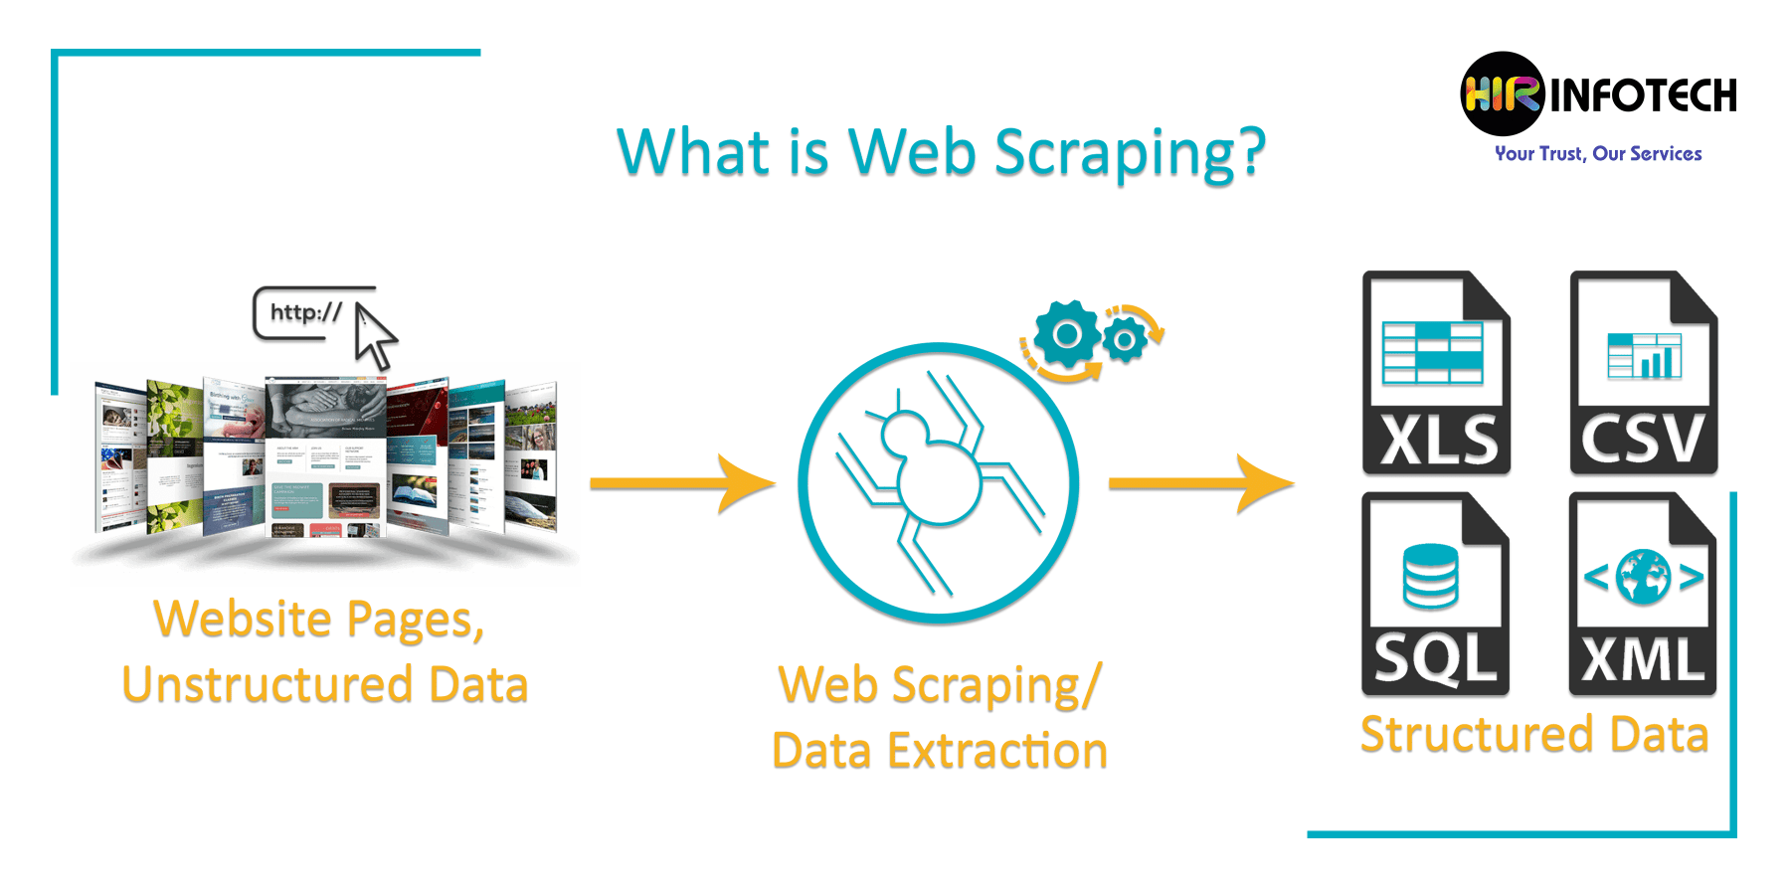
Collect & Process Data for you
Simple bots might get the job done, but more sophisticated bots use AI to find the appropriate data on a page & copy it to the appropriate data field to be processed by an analytics application.
Machine learning (ML) is the study of computer algorithms that improve automatically through experience. Machine learning algorithms build a mathematical model based on sample data, known as "training data", in order to make predictions or decisions without being explicitly programmed to do so.
Notes:
Web scraping refers to the method of collecting & structuring the data from web sources in a more convenient format. It involves no processing or review of the data.
Data mining refers to the method of analyzing large data sets to reveal useful information & patterns. It does not require data processing or extraction.
Data mining is not about extracting data. Web scraping may be used to build the datasets that are to be used in data mining.

Slide 4
How to Choose the Best Platform for YOU
Do you want a Public Affairs only system, to piggyback on a CRM / PR system, one tool or a toolbox?
Consider how much time needed to set up system
How much time to invest in maintaining system
Managing alerts, linking to issues, selecting issues
Define Power Users who hold institutional user knowledge
More tools = more power users
Consider GDPR implications
How much risk?

Slide 5
How to Choose the Best Platform for YOU
Events and timelines
Event calendar
Legislative timelines
Forecasting
Customisation
Adding notes
Tagging to issues
Grouping stakeholders
What level of support do you need: Hotlines / Support
What type of analysis do you need:
Parliamentary / event summaries
Document summaries
Commentary
Number and range of analysts
Trends, Visualisation, sentiment
What degree of detail do you want on stakeholders?
Stakeholder documents
Stakeholder events
Stakeholder contact details

Slide 6
How to compare platforms
All-in-one / Separate tools
Legislation & Documents
Stakeholder database
Timeline & Future Watch
Customizable – Own data
Visualizations: Trends
(Social) Media tracker tool
Weekly, monthly updates
Size / type of Analyst team
Briefings
PA only or business wide
Alerts
Notes:
Innovation capability matters
Number of issues tracked affects.

